Slide 1



Mapping of microRNA - mediated Gene Regulatory Networks across different tissues in Schizophrenia
Vishnu Priya Nuthanapati –100517731021
Project Mentor -
Dr. Suman Dabbu
Associate Professor
Department of Biomedical Engineering, UCEOU
Dr. Sujeethraj Koppolu
Research Mentor
CAMPUS Fellowship Program 2020

Slide 2









Schizophrenia is a chronic and severe mental disorder with a range of positive and negative symptoms
Positive Symptoms
Negative Symptoms
Hallucinations
Delusions
Depersonalization
Dissociative
Thoughts
Panic
Attack
Disorganized
Thinking
Depression
Hopelessness

Slide 3





Schizophrenia is primarily diagnosed through psychiatric evaluation and, currently, there is no cure for it.
Treatment Options
Factors affecting schizophrenia
The current treatment options are psychotherapy sessions and lifelong medications with anti-psychotic drugs
Genetic Factors are thought to
be the leading cause
Chemical imbalances in the brain like
dopamine and serotonin
History of drug abuse

Slide 4
Opportunities for identifying novel drug targets and biomarker discovery in Schizophrenia
Key Issues:
Schizophrenia is a non-curable disease diagnosed primarily by subjective psychiatric evaluations after manifestation of symptoms.
It can only be managed by treatment with antipsychotic drugs that, at best, have moderate efficacy with a high potential for relapse and side effects.
Goal of current project:
Identify:
potential biomarkers to aid in the early and objective diagnosis of schizophrenia before manifestation of symptoms
Potential drug targets to treat schizophrenia with high efficacy and minimal side effects
Approach:
Leveraging publicly available transcriptomic data, develop regulatory networks of genes most associated with schizophrenia in a tissue-cognizant manner to reduce unintended adverse effects
Key Results:
Identify potential microRNA -Gene regulatory network that is associated with Schizophrenia.
Map these microRNA – Gene regulatory networks across multiple tissues in a Schizophrenic case.
By finding such networks across multiple tissues, we discover the target genes which has the potential to act as a biomarker or a drug target with minimal side effects.

Slide 5
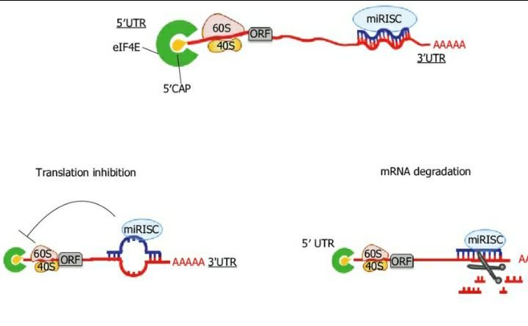
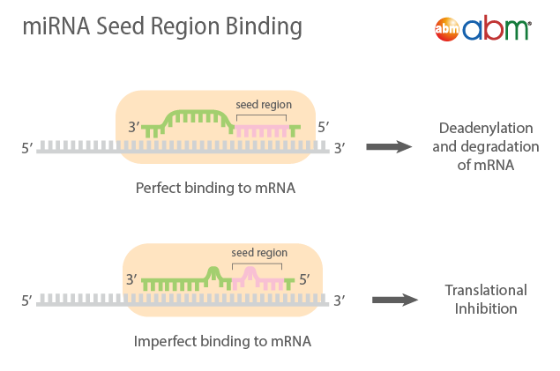
microRNAs are short non-coding RNAs that regulate protein expression levels by translational inhibition or mRNA degradation
The strength of the binding at the seed region determines the type of microRNA regulation

Slide 6

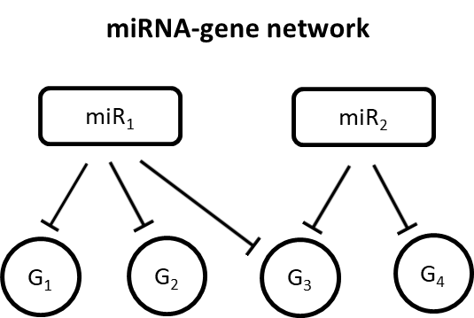
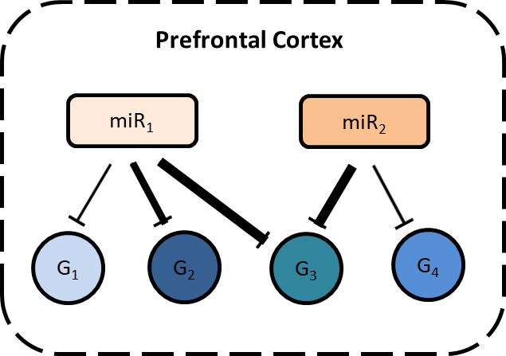
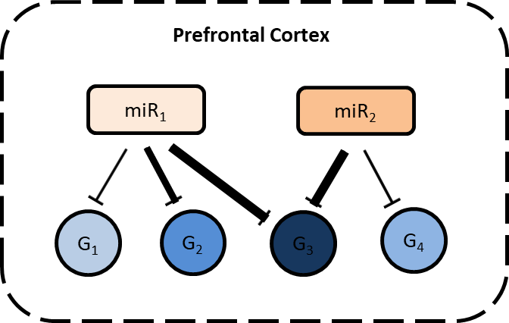
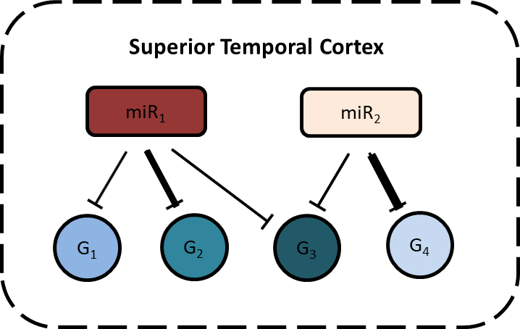
Our methodology

Slide 7
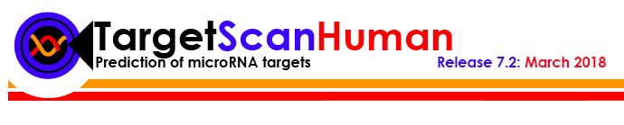
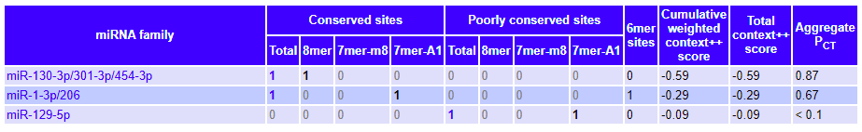
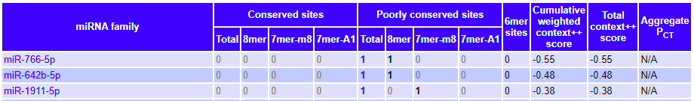
Step 1: Generate a universal microRNA-gene regulatory network template using target predictions from TargetScan algorithm
5 steps in generating the universal template network
Predictions for gene CALM2
Conserved miRNAs
Download the entire database of TargetScan 7.1
Combine the conserved and non-conserved target predictions for all miRNAs
Non-conserved miRNAs
Extract the relevant predictions for miRNAs in humans
Filter data to remove unwanted features and weaker associations
Create a finalized database of template network with microRNA target predictions.
Step 1: Make a universal miRNA-gene network template

Slide 8
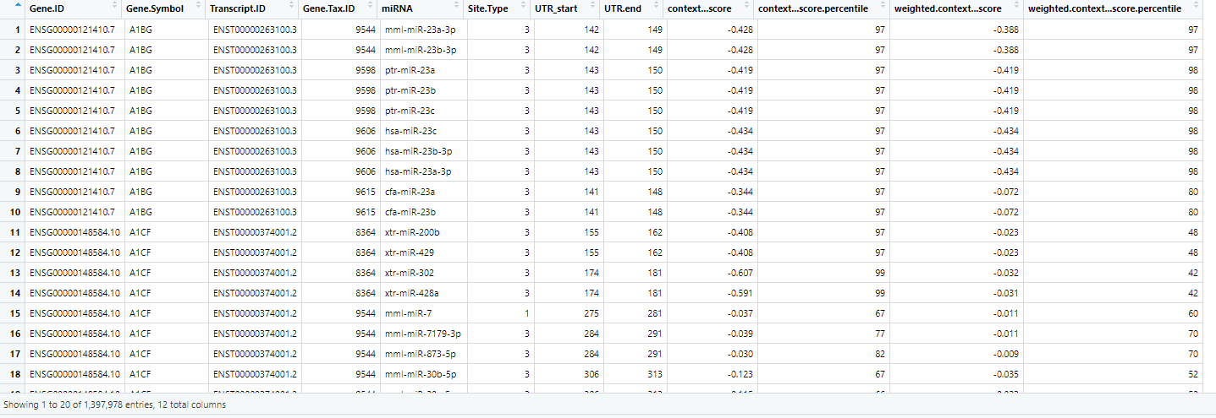
Step 1: Make a universal miRNA-gene network template

Slide 9
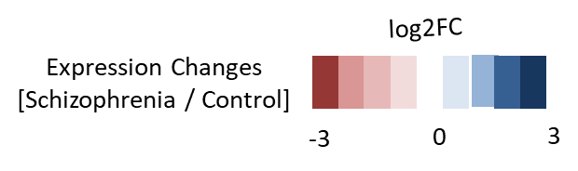

Our methodology
Step 2: Contextualization of networks with Schizophrenia

Slide 10
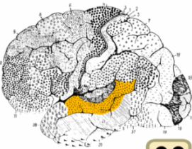
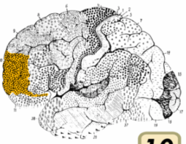
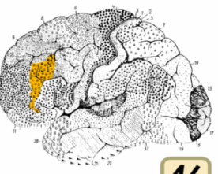

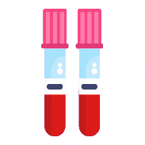



Tissues
BA22 area
BA10 area
BA46 area
Blood
Superior Temporal Cortex
Prefrontal Cortex
TISSUE | GENE DATASETS |  | MICRORNA DATASETS
 | SCZ Samples | Control Samples | SCZ Samples | Control Samples
BA 22 area | 23 | 19 | 21 | 21
BA 10 area | 15 | 15 | 15 | 15
BA 46 area | 86 | 88 | 95 | 97
PBMCs | 132 | 92 | 64 | 61
iPSCs | 4 | 4 | 18 | 18
Pluripotent Stem Cells (iPSCs)
Peripheral Blood Mononuclear Cells
(PBMCs)
Tissues considered for the project
Step 2: Contextualization of networks with Schizophrenia

Slide 11
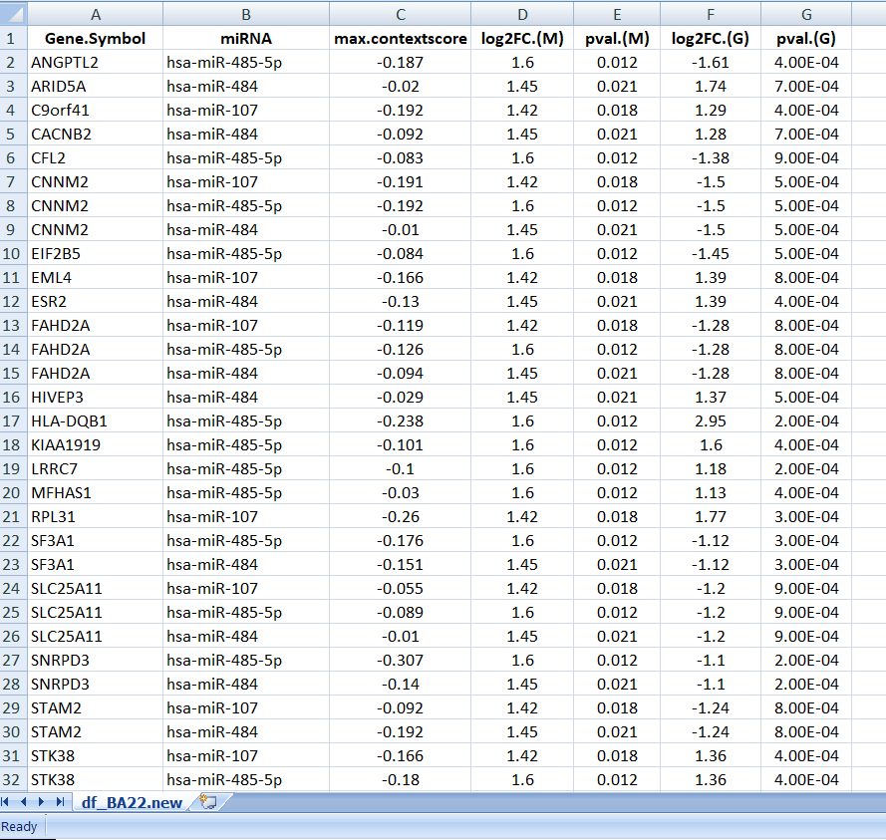
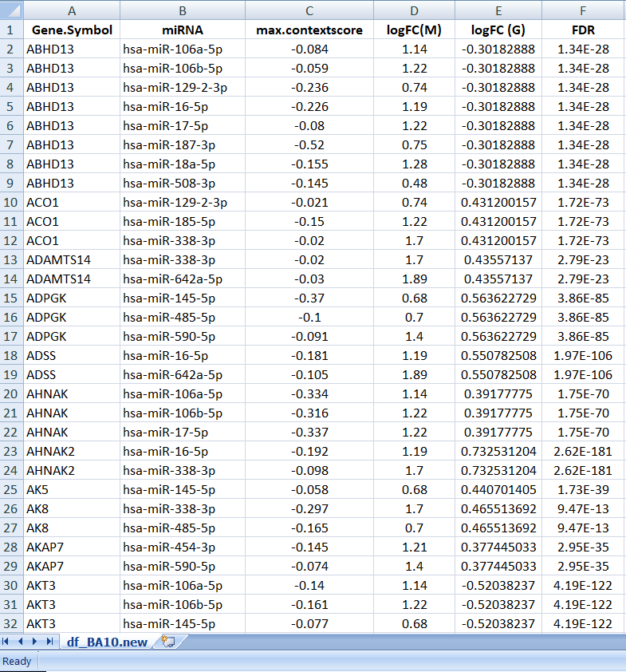
Step 2 Universal Network for Tissue
Step 2: Contextualization of networks with Schizophrenia

Slide 12
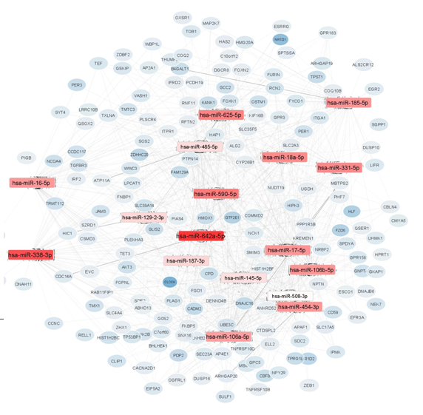
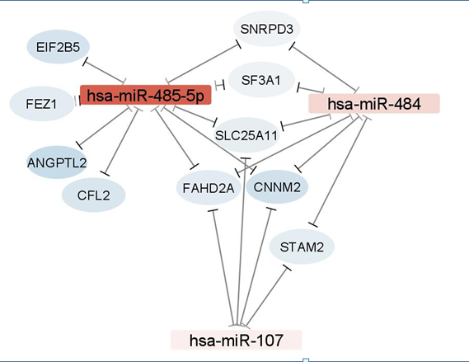
Step 2 - OUTPUTS OF METHODOLOGY Networking through Cytoscape Software
BA 22 – Up regulated MicroRNAs
BA 10 – Up regulated MicroRNAs
Step 2: Contextualization of networks with Schizophrenia

Slide 13
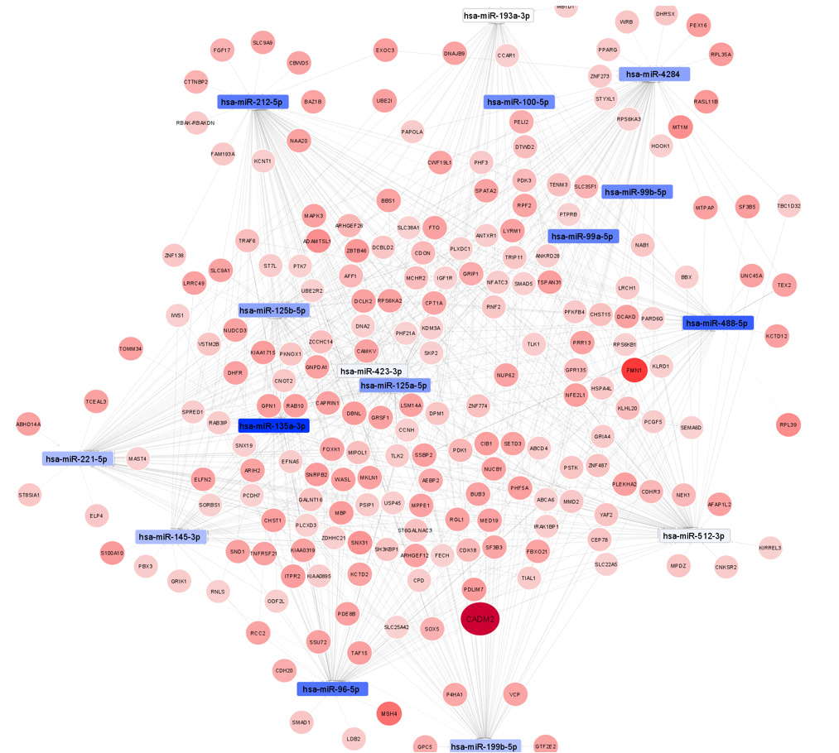
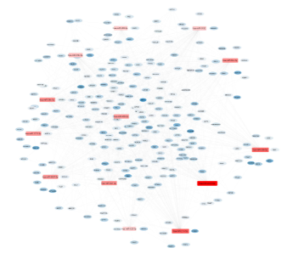
Step 2 - OUTPUTS OF METHODOLOGY Networking through Cytoscape Software
BA 46 – Down regulated MicroRNAs
BA 46 – Up regulated MicroRNAs
The darker regions are highly expressive
Step 2: Contextualization of networks with Schizophrenia

Slide 14
Our methodology
Step 3: Comparison of networks across multiple tissues

Slide 15
Prefrontal Cortex - BA46 region
MOST REGULATED microRNA
microRNAs that are having interactions with more Genes
MOST REGULATED Genes
Genes that are having interactions with more number of microRNAs
Total MicroRNAs - 50
Total Genes - 2813

Slide 16
Prefrontal Cortex - BA46 region

Slide 17
Prefrontal Cortex - BA46 region

Slide 18
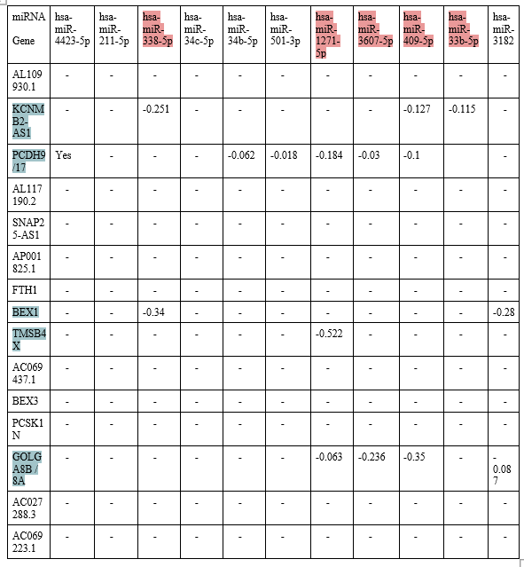
Gene-microRNA Interactions with high fold changes
Up-Regulated network Interactions
Above reactions are important.
microRNA:
hsa-miR-338-5p
hsa-miR-1271-5p
hsa-miR-3607-5p
hsa-miR-409-5p
hsa-miR-3182
Genes:
KCNMB2-AS1
PCDH9/17
BEX1
GOLGA8B / 8A
TMSB4X

Slide 19
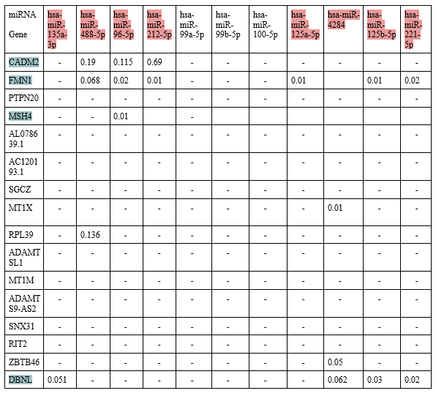
Gene-microRNA Interactions with high fold changes
Down-Regulated network interactions
The important MicroRNAs and Genes are :
microRNA:
hsa-miR-135a-3p
hsa-miR-488-5p
hsa-miR-96-5p
hsa-miR-212-5p
hsa-miR-125a-5p
hsa-miR-4284
hsa-miR-125b-5p
hsa-miR-221-5p
Genes:
CADM2
FMN1
DBNL
MSH4
MT1X
RPL39
ZBTB46

Slide 20
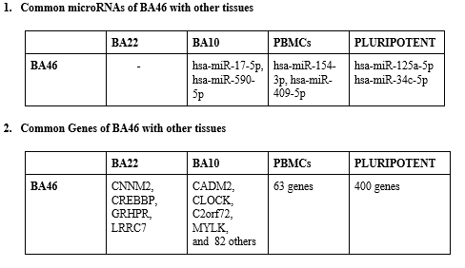
CROSS TISSUE COMPARISON (BA46)

Slide 21
Drugs Targets – BA46 Most Regulated Genes
Down regulated Genes
PCHD2
Valproic Acid – Up regulates the Gene expression (Treatment Purpose)
PCHD17
Valproic Acid – Up regulates the Gene expression (Treatment Purpose)
BEX1
Valproic Acid – Up regulates the Gene Expression
GOLGA8B/8A
Valproic Acid – Up regulates the Gene Expression
TMSB4X
Aspirin – Up regulates the Gene expression ( The research is going on whether it is potential drug for schizophrenia )
Up regulated Genes
MSH4
Estradiol – down regulates the Gene expression
MTIX
Estradiol – down regulates the Gene Expression
ZBTB46
VorinoStat – down regulates the Gene Expression ( withdrawn from treatment)

Slide 22
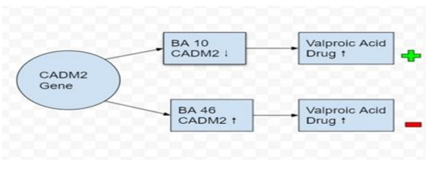
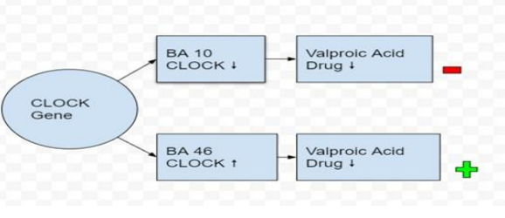
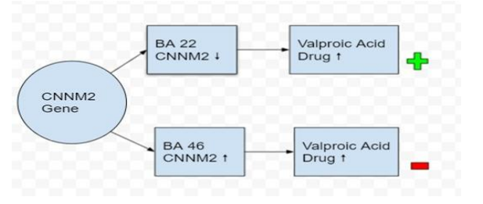
DRUG EFFECTS ACROSS TISSUES
Drug effect-CADM2 Gene in BA10 vs. BA46
Drug effect CLOCK Gene in BA10 vs. BA46
Side effects of valproic acid
Abnormal thinking
Uncontrollable shaking of the body
Problems with coordination or walking
Uncontrollable movements of the eye
Drug effect CNNM2 Gene in BA22 vs. BA46

Slide 23
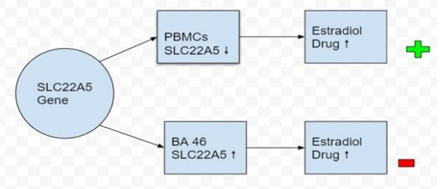
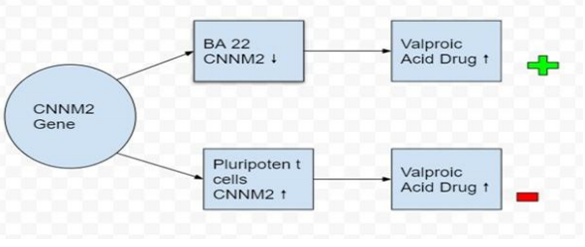
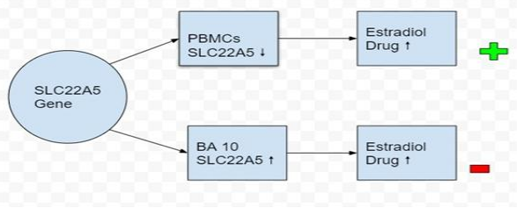
DRUG EFFECTS ACROSS TISSUES
Drug effect CNNM2 Gene in BA22 vs. Pluripotent
Drug effect SLC22A5 Gene in PBMCs vs. BA46
Side effects of Estradiol:
Abdominal cramping.
Anxiety.
Bloating.
Breakthrough bleeding.
Breast enlargement & Changes in menstrual periods.
Drug effect SLC22A5 Gene in BA10 vs. PBMCs

Slide 24
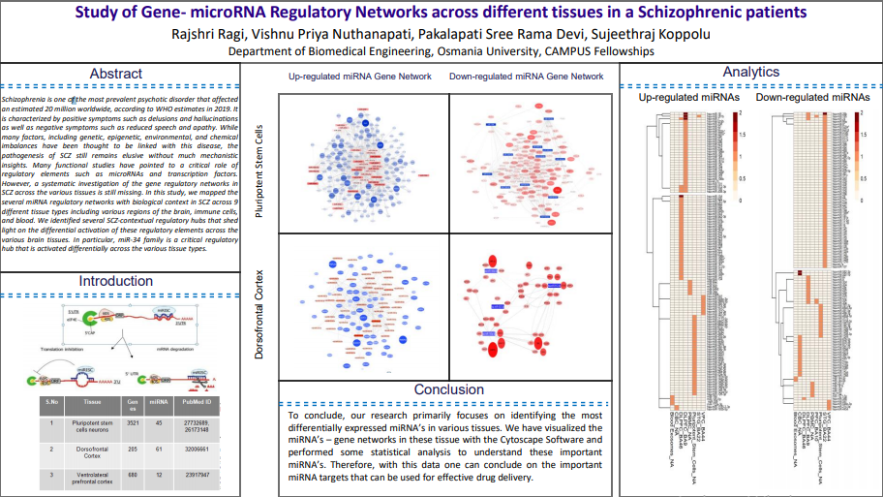
POSTER PRESENTED AT INTERNATIONAL EXPERIMENTAL BIOLOGY(2021) CONFERENCE

Slide 25


